Slide 1
EOS Coalition
Program and Operations Health
12 MAY 2022

Slide 2
Health Scorecard
 |  | Program | Headline | Apr | May | Jun | Jul | Aug | Sep | Oct | Nov | Dec | Jan | Feb | Mar
 |  | 1 - ARP Team | RFP development in process
 |  | 2 - Transaction Lifecycle | Code complete; ready for Mandel 3.1 deployment
 |  | 3 - Specialized APIs | RFP development in process
 |  | 4 - Centralized APIs | RFP development in process
 |  | 4 - Secure Smart Contract Libraries | RFP review by Working Group
 |  | 6 - Automated Security Audit Tools | RFP development in process
 |  | 8 - EOSIO External Security Audit | RFP development in process
 |  | 1 - Faster Finality | RFP review by Working Group
 |  | 4 - Trustless Cross-chain IBC | RFP development in process
 |  | 3 - P2P Code Rewrite | RFP development in process
 |  | 6 - RAM Limitation Fixes | RFP development in process
 |  | 9 - State Proofs and Full Validation | RFP development in process
 |  | 1 - SDKs | RFP review by Working Group
 |  | 2 - Application Registry | RFP review by Working Group
 |  | 3 - Request for Permission | RFP development in process
 |  | 2 - Synchronous Calls | Executive Summary and requirements in process
 |  | 13 - Improved Token Standards | Executive Summary and requirements in process
 |  | 10 - dStor Concept | Executive Summary and requirements in process
 |  | 5 - Read Only Actions | Executive Summary and requirements in process
 |  | Core+ 27- Contract Pays | Executive Summary and requirements in process
API+
Audit+
Scalability+
Wallet+
Ad Hoc
 | Active Project
 | Planned Future Schedule

Slide 3
 | API+ Program |  |  | Three projects in RFP development stage. Transaction Lifecycle is code complete and mating for Mandel 3.1 Release. |  |  |  |  |  |  |  | 12 MAY 2022
 | Schedule |  |  |  |  | Scope |  |  |  |  | Risks
 | Project Name |  | Completion |  |  | Project |  |  |  |  | Feedback from working groups on RFPs often delayed
 | 1 - ARP Team RFP |  |  |  |  | 1 - ARP Team RFP |  |  | N/A
 | 2 - Transaction Lifecycle |  | 31 MAY 22 |  |  | 2 - Transaction Lifecycle
 | 3 - Specialized APIs RFP |  |  |  |  | 3 - Specialized APIs RFP |  |  | N/A
 | 4 - Centralized APIs RFP |  |  |  |  | 4 - Centralized APIs RFP |  |  | N/A
 | Integration / Dependencies |  |  |  |  | Communication |  |  |  |  | Budget
 | None |  |  |  |  | Target | Last | Next |  |  | Project | Planned | EAC
 |  |  |  |  |  | Core Team (weekly) |  |  |  |  | 1 - ARP Team RFP | N/A
 |  |  |  |  |  | Working Group (weekly) |  |  |  |  | 2 - Transaction Lifecycle
 |  |  |  |  |  | Community (monthly) |  |  |  |  | 3 - Specialized APIs RFP | N/A
 |  |  |  |  |  |  |  |  |  |  | 4 - Centralized APIs RFP | N/A
 | Quality / Total Open Bugs |  |  |  |  | Procurement |  |  |  |  | Resources
 | Project | Current | Previous |  |  | 1 - ARP Team RFP | Waiting on RFP |  |  |  | Project
 | 1 - ARP Team RFP | N/A | N/A | N/A |  | 3 - Specialized APIs RFP | Waiting on RFP |  |  |  | 1 - ARP Team RFP | Contract Needed
 | 2 - Transaction Lifecycle |  |  |  |  | 4 - Centralized APIs RFP | Waiting on RFP |  |  |  | 2 - Transaction Lifecycle
 | 3 - Specialized APIs RFP | N/A | N/A |  |  |  |  |  |  |  | 3 - Specialized APIs RFP | Contract Needed
 | 4 - Centralized APIs RFP | N/A | N/A |  |  |  |  |  |  |  | 4 - Centralized APIs RFP | Contract Needed

Slide 4
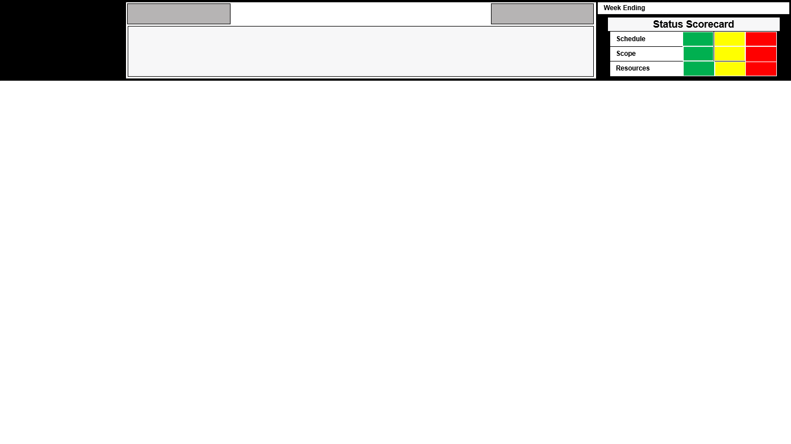

API+
Transaction Lifecycle
Object Computing
2022/05/06
EOSIO+ Coalition
Project Description:OCI, in collaboration with EOS Network Foundation (Client), will develop enhancements to EOS Core functionality to improve the end-user experience. OCI will focus on four (4) primary Scope Items as follows: Transaction Retry; Transaction Finality Status; Transaction Resource Cost Estimation; and Subjective Billing Improvements.
Highlights / Accomplishments
Key Milestones
March 2022
Completed 90% of the Limited Storage Epic
Completed atl requirements Jira stories for the remaining 4 epics
April 2022 (current as of the week ending April 29)
Limited Storage epic: 100% complete
Subjective Billing Improvements epic: 100% complete
Transaction Resource Cost Estimation epic: 100% complete
Transaction Retry epic: 100% complete
Transaction Finality Status epic: 90% complete
Description | Planned Date | Actual Date
Limited Storage Epic | March 30 | April 3
Subjective Billing Improvements Epic | April 15 | May 6
Transaction Resource Cost Estimation Epic | April 30 | April 22
Transaction Retry Epic | May 15 | April 29
Transaction Finality Status Epic | May 31
Upcoming Activities
Issues / Risks / Escalations
We also have begun initial work on the Second SOW, which for the time being will focus on Code Updates for Mandel 3.1.
A complete list of all complete issues are included in Alice’s weekly OCI report
Going forward Alice and Kevin will ensure that all issues in work are clearly posted in ENF’s GitHub repository.
Nothing to report at this time

